Slide 1
2020 BGC FO Learning Review– Apr.28.2020
LIU Lin, XU Ziyuan, ZHANG Shishi, ZHANG Jialong
Mentor: QIU Yue(Grace)

Slide 2
Agenda
Topics | Presenter | Time
Learning C# Programming | ZHANG Jialong | 6 min
Projects and Skills | XU Ziyuan | 6 min
Windows Forms Application & Demo | LIU Lin | 10 min
Quality Management | ZHANG Shishi | 6 min
Q&A | All | 10 min

Slide 3
C# Programming
ZHANG Jialong

Slide 4
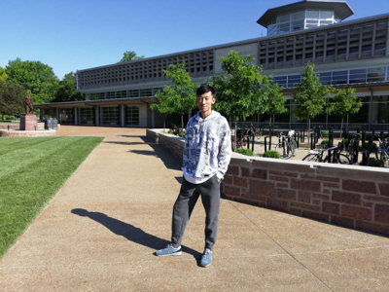
Self Introduction -- ZHANG Jialong 张嘉龙
Desktop Software Engineer in OWP Deliverables
--Direct Manager: WANG Xi
--Mentor: GE Tong
Washington University in St. Louis
--Master of Science in EE
Renmin University of China
--Bachelor of Science in Physics

Slide 5
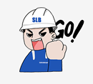
Daily Schedule
Daily Stand-up Meeting 9:00 – 9:30
WeChat Voice Call;
Context and Knowledge Sharing by Grace;
Status Sharing/Plan Making;
Daily Review 18:00
Status Sharing in WeChat;
Code Review; Help Session;
Interactive Real-Time Learning;
Free Discussion Chatroom all-day

Slide 6

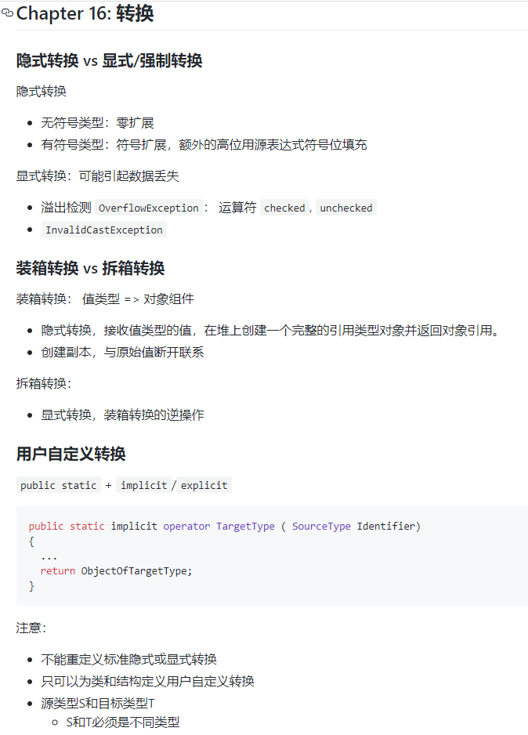
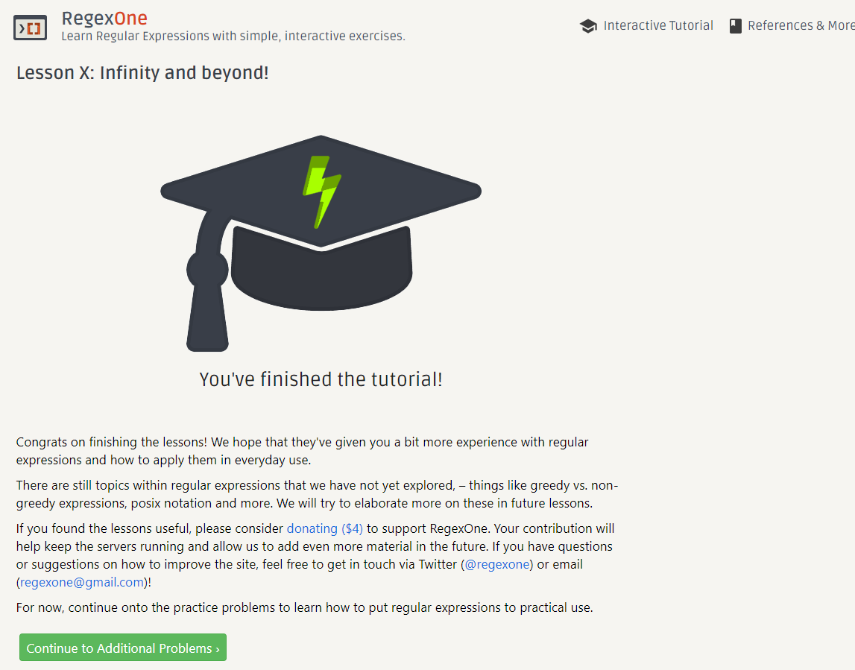
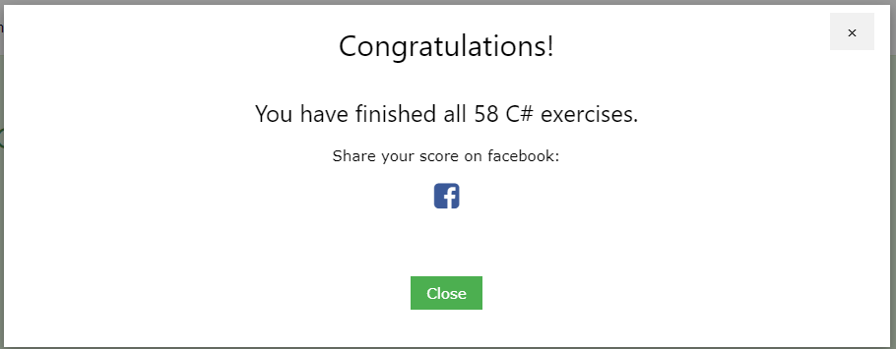
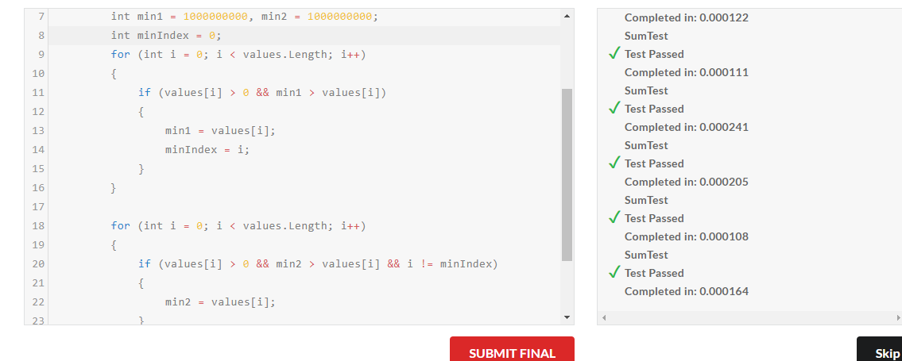
Learning the C# Language
Text book: Illustrated C# 7 (C#图解教程）
https://github.com/Archangelxzy/Csharp--/blob/master/ReadNote.md by LIU Lin
Programming Practices: Edabit, Leetcode, RegexOne, etc.
https://github.com/jzhang182
Further learning materials: Microsoft documents, Pluralsight, etc.

Slide 7
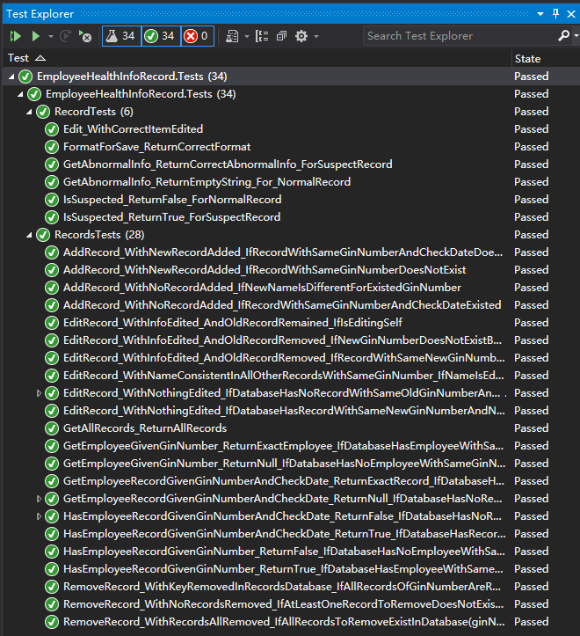
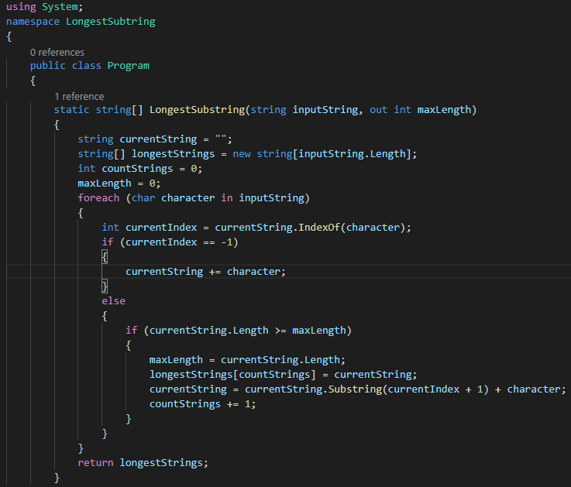

Softwares and extensions usage
Coding: Visual Studio Code, Visual Studio 2019 Community
Quality Management:
Unit Test: Xunit, OpenCover
Test Case Design: Xmind/MindMaster.
Code/Project management: Github

Slide 8
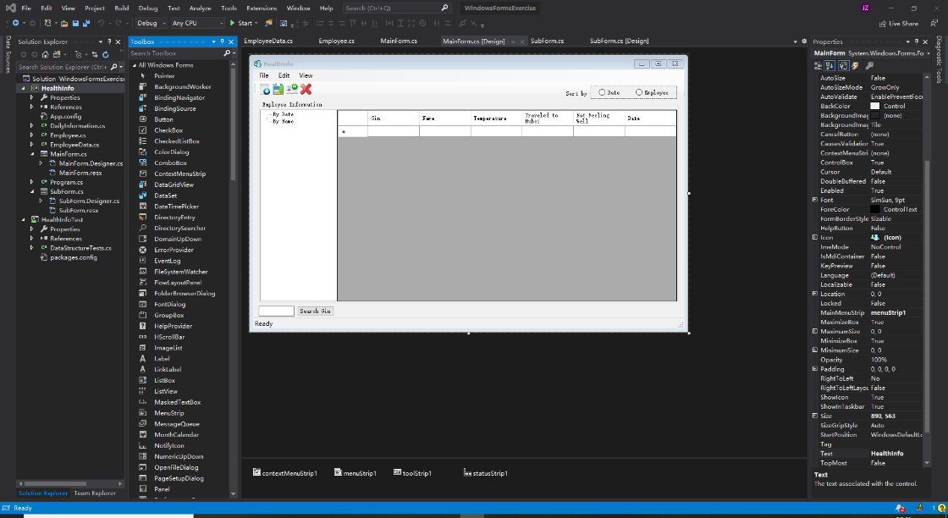
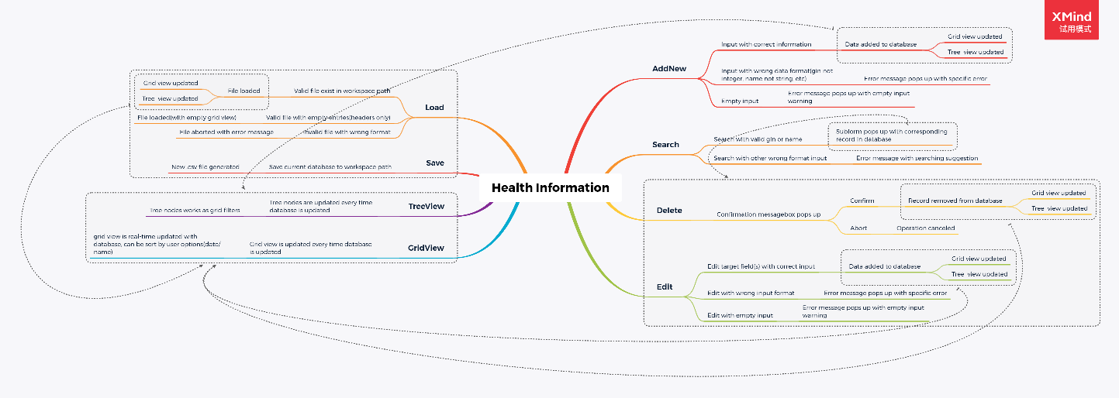
Individual Projects and Testing
Coding exercises and challenges
Algorithms: Searching, Sorting, etc.
Performance: Speed, Stability
Maintainability/Testability: Naming and coding Standards
Console Apps
Trajectory Views
Daily Health Monitoring
Unit testing and UX
Windows Forms Apps
Daily Health Monitoring
Test Cases
Mind Maps

Slide 9
Programming and developing skills Console application
XU Ziyuan

Slide 10

Self Introduction
XU Ziyuan （徐梓源）
2017-2020 Beihang University Computer Science
2014-2015 Baker Hughes FE
2010-2014 China University of Petroleum (Beijing) Petroleum engineering

Slide 11
Programming and developing skills – Console application
Stage key points:
Console application
Coding standards
Object-oriented programming
Model-View Separation
Unit test

Slide 12
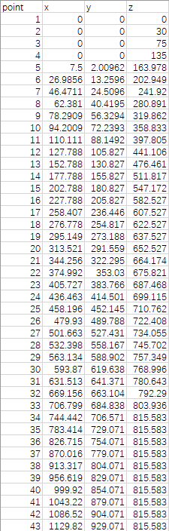
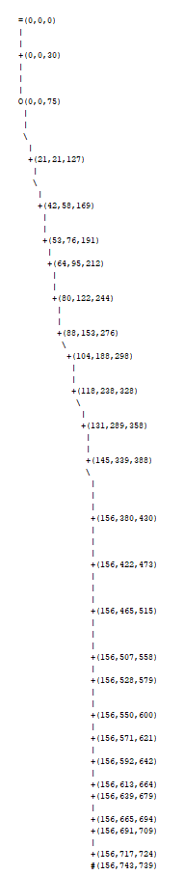
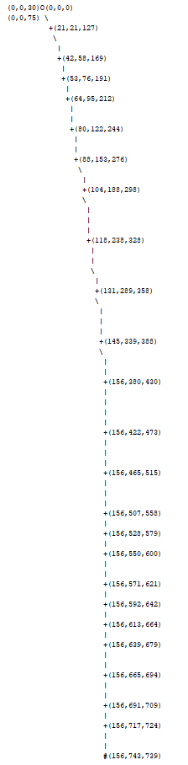
Programming and developing skills – Console application
Project: Well Trajectory Visualization
Console application
Well trajectory consists of series of 3D points
Calculate three orthographic projections of trajectory
Using txt file to output graph
Use ‘+’ to represent data points
Use ‘O’ for the maximum curvature point
Use ‘\’ ‘/’ ‘|’ ‘-’ to indicate trajectory shape between two points
Annotate point’s coordinates beside the point

Slide 13
Programming and developing skills – Console application
Point3D
Project: Well Trajectory Visualization
Geometry data model
Three orthographic view projection data model
Image data model
Drawing trajectory’s three-view profile in text file
Unit convert and scaling
Change direction of projection
Unit test
x
y
z

Slide 14
Programming and developing skills – Console application
Point3D
Project: Well Trajectory Visualization
Geometry data model
Three orthographic view projection data model
Image data model
Drawing trajectory’s three-view profile in text file
Unit convert and scaling
Change direction of projection
Unit test
x
y
z
Trajectory3D
point3D_0
point3D_1
point3D_2
point3D_3
……
point3D_n

Slide 15
Programming and developing skills – Console application
Point3D
Point2D
Project: Well Trajectory Visualization
Geometry data model
Three orthographic view projection data model
Image data model
Drawing trajectory’s three-view profile in text file
Unit convert and scaling
Change direction of projection
Unit test
x
y
z
x
y
Trajectory3D
Trajectory2D
point3D_0
point3D_1
point3D_2
point2D_0
point2D_1
point2D_2
point3D_3
……
point3D_n
point2D_3
……
point2D_n

Slide 16
Programming and developing skills – Console application
Point3D
Point2D
Project: Well Trajectory Visualization
Geometry data model
Three orthographic view projection data model
Image data model
Drawing trajectory’s three-view profile in text file
Unit convert and scaling
Change direction of projection
Unit test
x
y
z
x
y
Trajectory3D
Trajectory2D
point3D_0
point3D_1
point3D_2
point2D_0
point2D_1
point2D_2
point3D_3
……
point3D_n
point2D_3
……
point2D_n
Canvas(Pixel Matrix)
Pixel
pixel_0
pixel_1
pixel_2
I
J
pixel_3
……
pixel_n
character

Slide 17
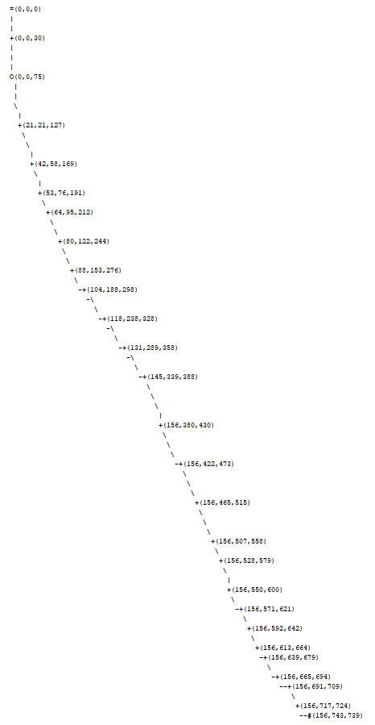
Programming and developing skills – Console application
Project: Well Trajectory Visualization
Geometry data model
Three orthographic view projection data model
Image data model
Drawing trajectory’s three-view profile in text file
Unit convert and scaling
Change direction of projection
Unit test

Slide 18
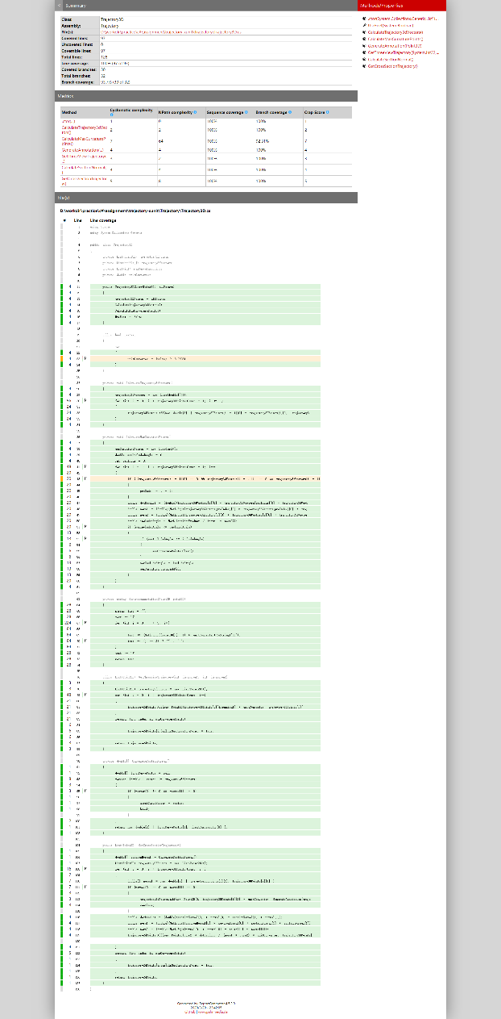
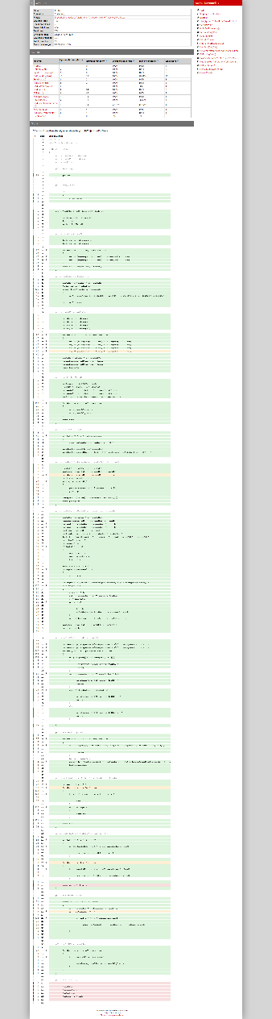
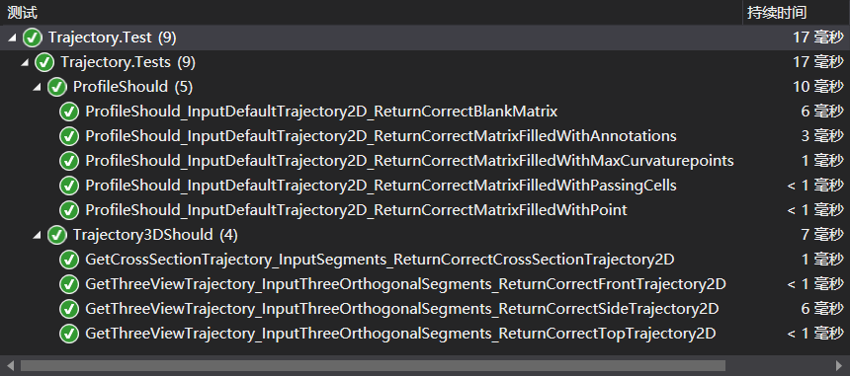
Programming and developing skills – Console application
Project: Well Trajectory Visualization
Geometry data model
Three orthographic view projection data model
Image data model
Drawing trajectory’s three-view profile in text file
Unit convert and scaling
Change direction of projection
Unit test

Slide 19
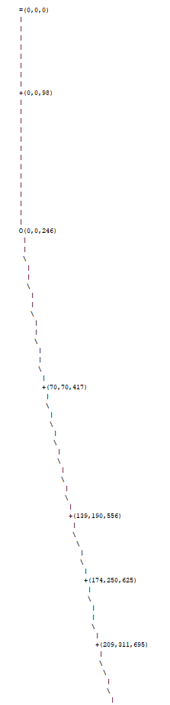
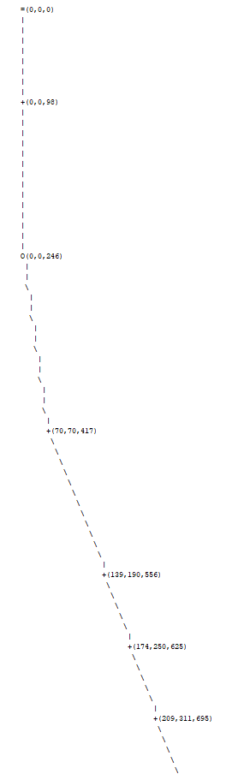
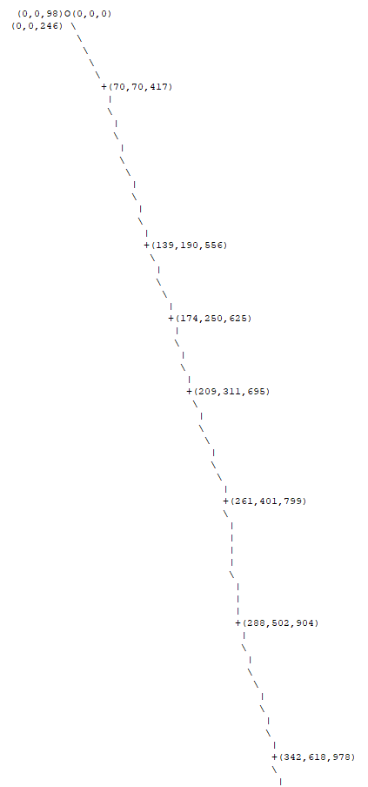
Programming and developing skills – Console application
Project: Well Trajectory Visualization
Geometry data model
Three orthographic view projection data model
Image data model
Drawing trajectory’s three-view profile in text file
Unit convert and scaling
Change direction of projection
Unit test

Slide 20
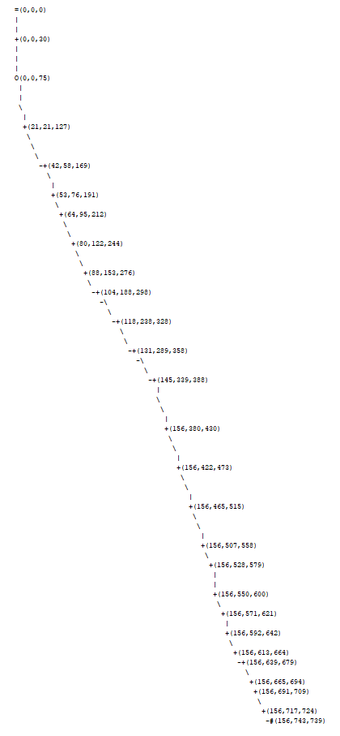
Programming and developing skills – Console application
Project: Well Trajectory Visualization
Geometry data model
Three orthographic view projection data model
Image data model
Drawing trajectory’s three-view profile in text file
Unit convert and scaling
Change direction of projection
Unit test

Slide 21
Programming and developing skills – Console application
Project: Daily Health Monitor
Record employees’ health data
Provide access to add, modify, delete and search for operations
Console interaction
Data persistence to file

Slide 22
Programming and developing skills – Console application
Project: Daily Health Monitor
Employee
Health data
Data Management
Persistence – csv / txt files
Exception handling and input check
User interface – console command line
Unit test
Employee
Gin
Name

Slide 23
Programming and developing skills – Console application
Project: Daily Health Monitor
Employee
Health data
Data Management
Persistence – csv / txt files
Exception handling and input check
User interface – console command line
Unit test
Employee
Health Data
Gin
Name
Health Data
Temperature
HB Visited
Symptom

Slide 24
Programming and developing skills – Console application
Project: Daily Health Monitor
Employee
Health data
Data Management
Persistence – csv / txt files
Exception handling and input check
User interface – console command line
Unit test
Data Management
Add
Delete
Modify
Search
Data Storage
emplyee_0
emplyee_1
emplyee_2
emplyee_3
emplyee_4
……
emplyee_n
Employee
Health Data
Gin
Name
Health Data
Temperature
HB Visited
Symptom

Slide 25
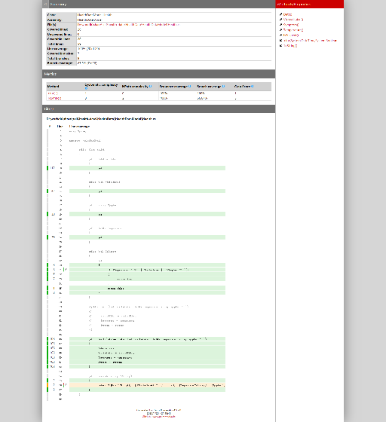
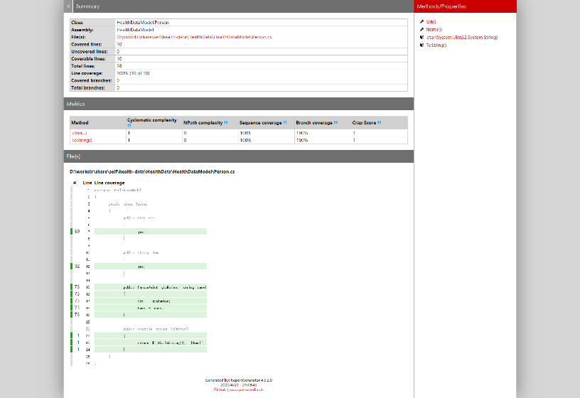
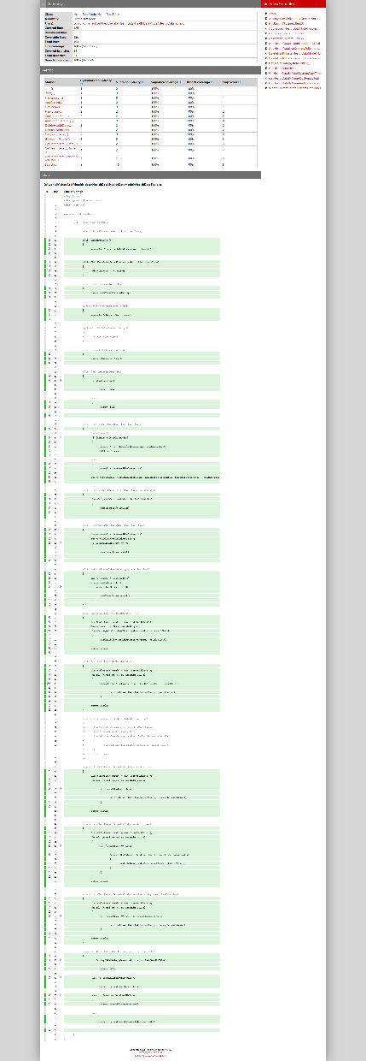
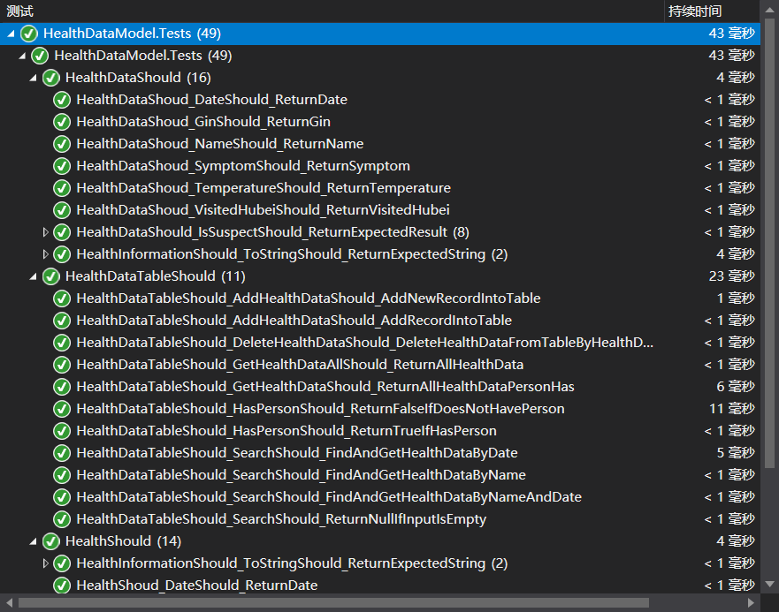
Programming and developing skills – Console application
Project: Daily Health Monitor
Employee
Health data
Data Management
Persistence – csv / txt files
Exception handling and input check
User interface – console command line
Unit test

Slide 26
Programming and developing skills – Console application
Project: Daily Health Monitor
Employee
Health data
Data Management
Persistence – csv / txt files
Exception handling and input check
User interface – console command line
Unit test
File operations
Input check
Data Management
Add
Delete
Modify
Search
Data Storage
emplyee_0
emplyee_1
emplyee_2
emplyee_3
emplyee_4
……
emplyee_n
Employee
Health Data
Gin
Name
Health Data
Temperature
HB Visited
Symptom

Slide 27
Programming and developing skills – Console application
Console Application
Project: Daily Health Monitor
Employee
Health data
Data Management
Persistence – csv / txt files
Exception handling and input check
User interface – console command line
Unit test
File operations
Input check
Data Management
Add
Delete
Modify
Search
Data Storage
emplyee_0
emplyee_1
emplyee_2
emplyee_3
emplyee_4
……
emplyee_n
Employee
Health Data
Gin
Name
Health Data
Temperature
HB Visited
Symptom

Slide 28
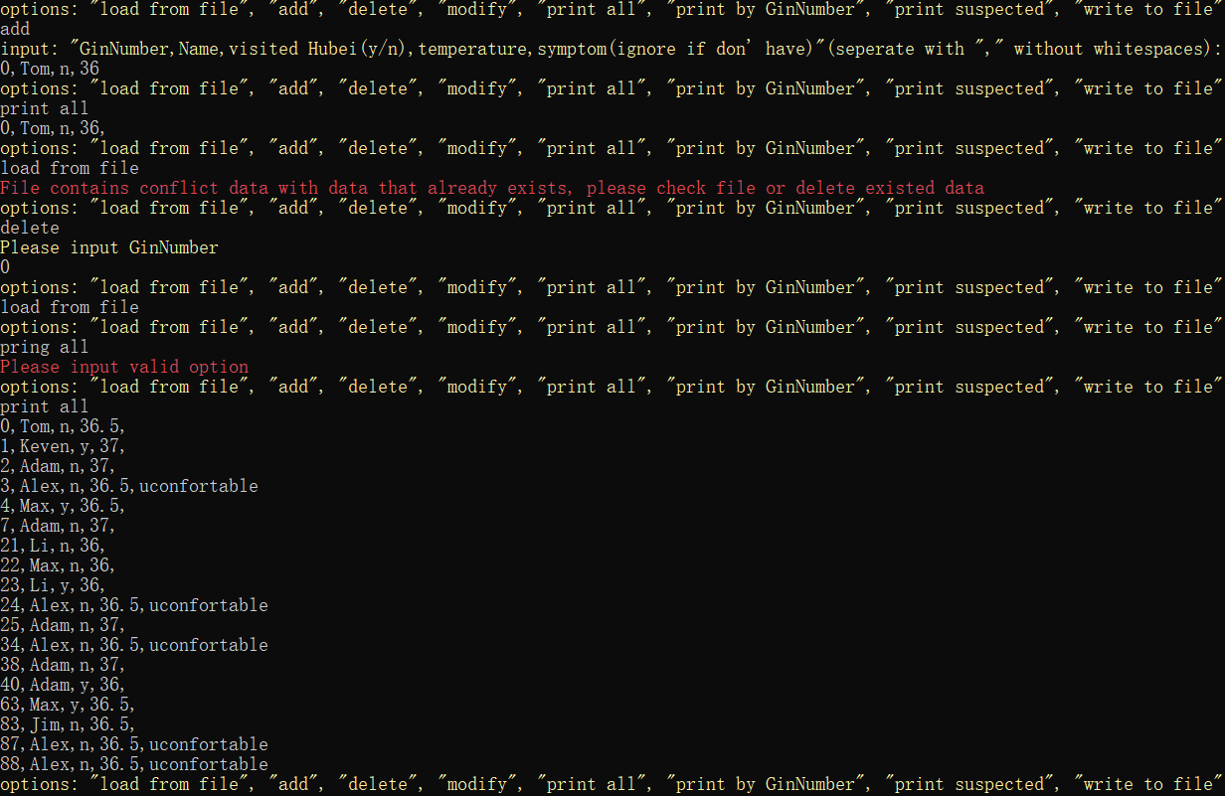
Programming and developing skills – Console application
Project: Daily Health Monitor
Employee
Health data
Data Management
Persistence – csv / txt files
Exception handling and input check
User interface – console command line
Unit test

Slide 29
Programming and developing skills – Console application
Stage key points:
Coding standards – Maintainability, Readability
Object-oriented programming – Increase program size, variety of functions
Model-View Separation – Hierarchical structure program
Unit test – TDD methodology, safety refactoring

Slide 30
Windows Forms Applications – case: Employee Daily Health Monitor
LIU Lin

Slide 31
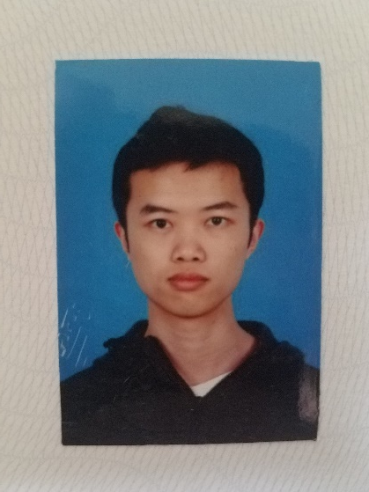
Self-Introduction
LIU Lin / 刘林, (future) Project Engineer
L’École centrale de Pékin, Beihang University (BUAA)
Master degree, Control Science and Engineering
Bachelor degree, Mathematics and Applied Mathematics

Slide 32
Objective
Learn building graphically rich interactive applications
Learn Windows Forms programming
Windows Forms controls
Handling of user inputs, event handlers
UI & UX design
Learn quality management

Slide 33
Employee Daily Health Monitor - Requirements
Basic operations: Add, Edit, Delete, Load, Save
Filters: Date, Name, GinNumber, Suspects
User Experience
Shortcuts support
Error messages
Full-featured, but also easy to use

Slide 34
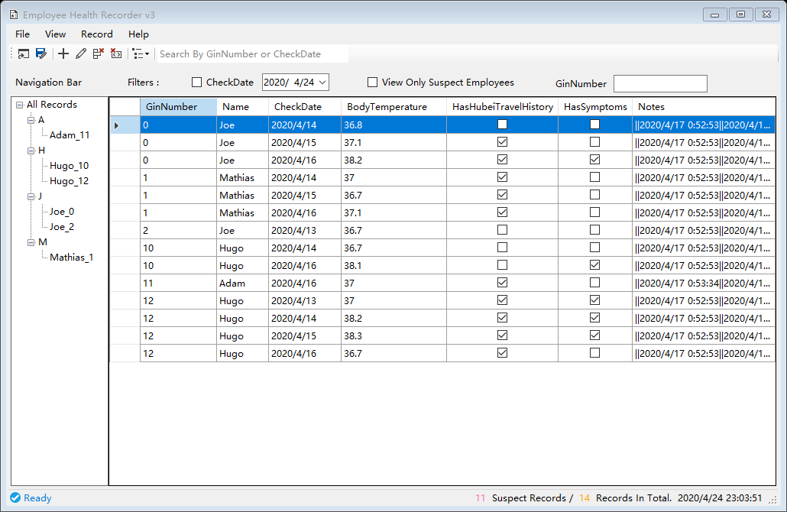
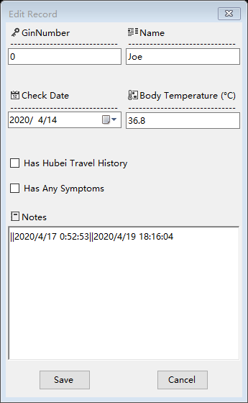
Employee Daily Health Monitor - Solution
Records Explorer
Record Editor

Slide 35
Employee Daily Health Monitor - Demo

Slide 36
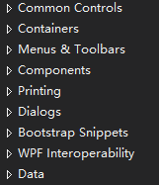
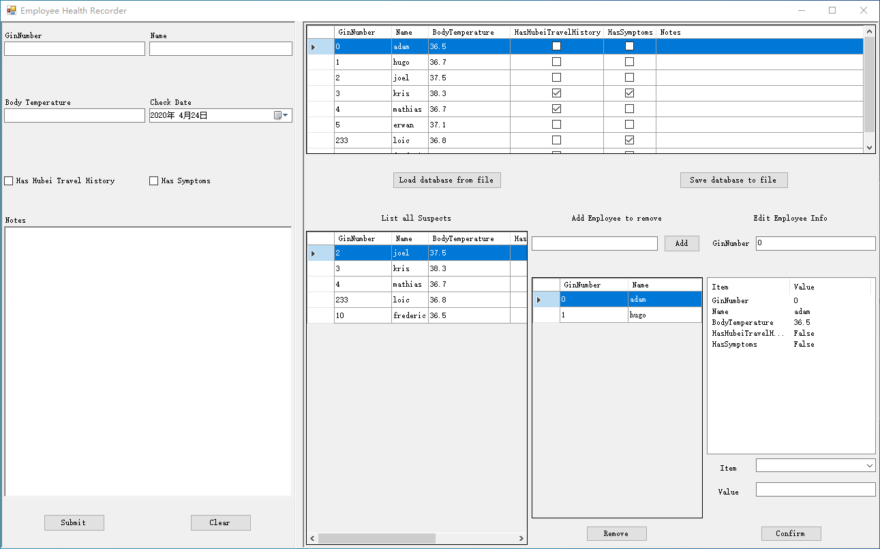
Employee Daily Health Monitor - Conclusion
Take four weeks from beginning to a deliverable application
What we have learned
Windows Forms programming
Good UI & UX design
Continuous Development & Continuous Testing
Future works: performance improvement, database, etc.
List of controls
Solution v0

Slide 37
Quality Management
ZHANG Shishi

Slide 38

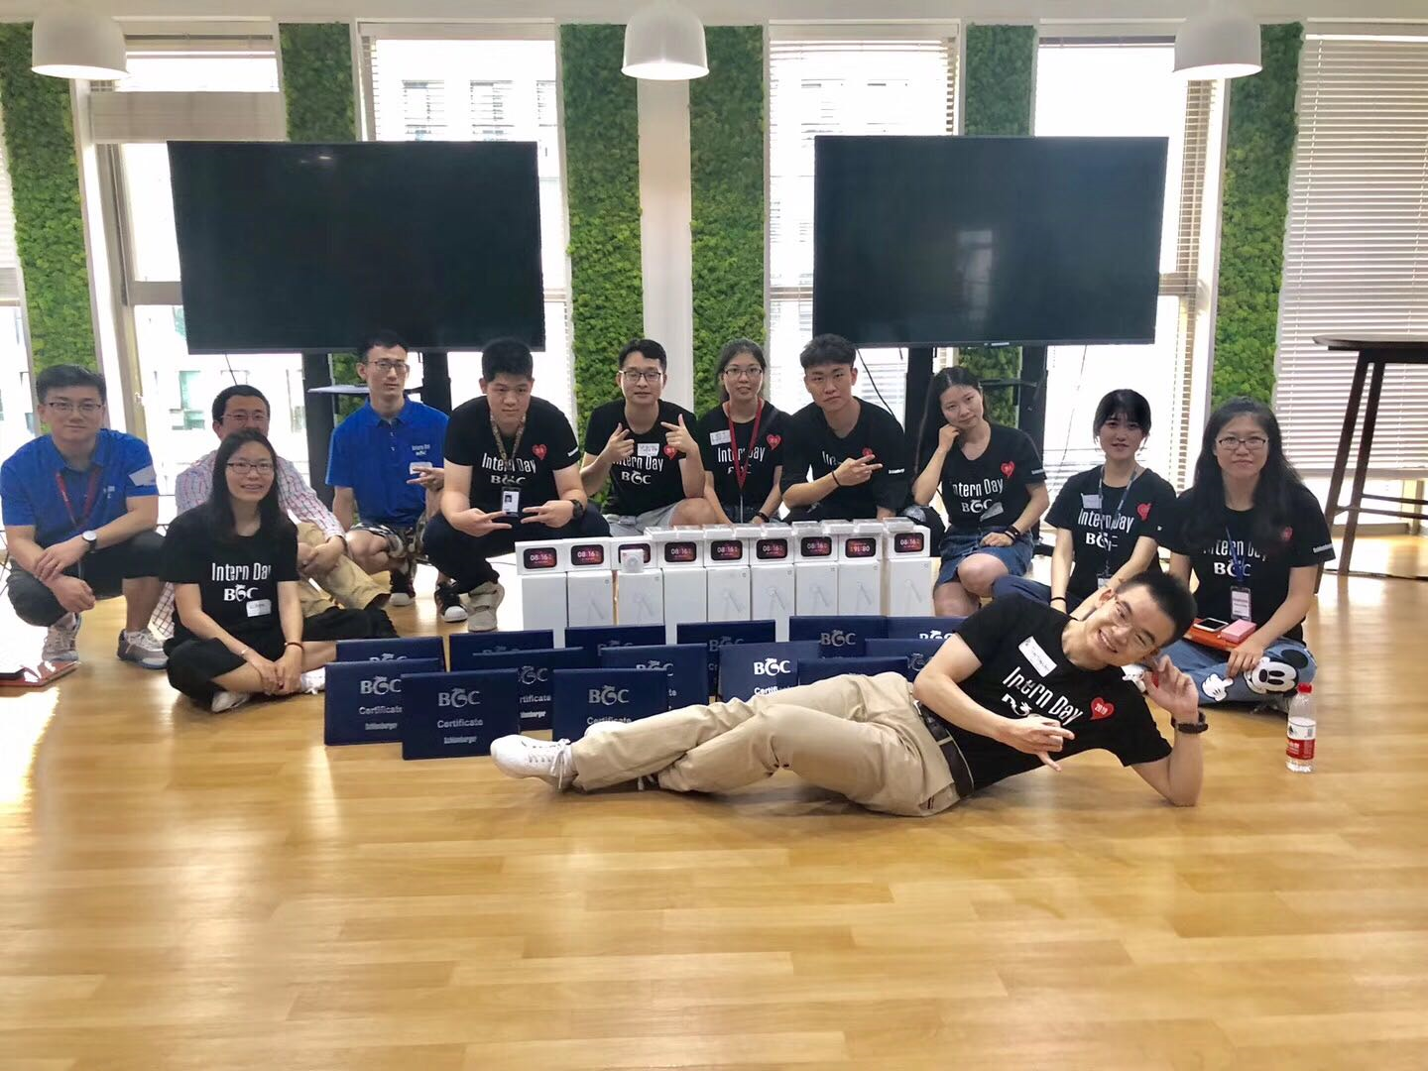

Shishi Zhang (张师师)
Pennsylvania State University, Petroleum and Natural Gas Engineering
Cornell University, Systems Engineering
2019 Summer Intern in BGC

Slide 39

Quality Management
What did we learn?
The importance of quality management.
General knowledge of the quality management in Schlumberger.
Design healthy, fast and maintainable tests.

Slide 40
Quality Management: Daily Health Monitor Project
Slower
UI
Tests
Service Tests
Unit Tests
Higher Cost
Clarify requirements
Unit tests
Test cases
Test cases review / code review
Regression test after update
Faster
Lower Cost

Slide 41
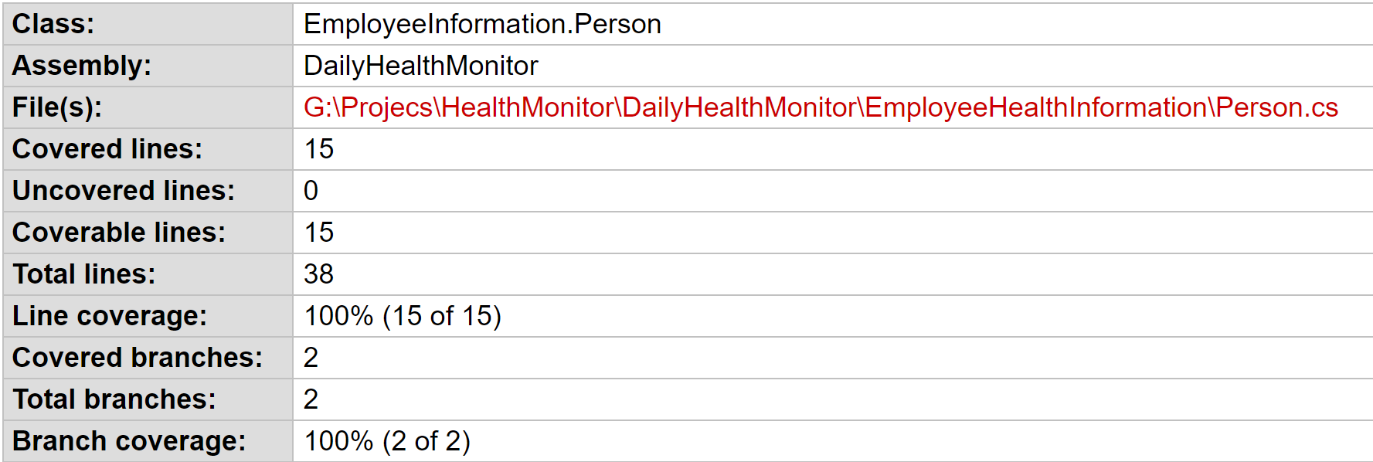
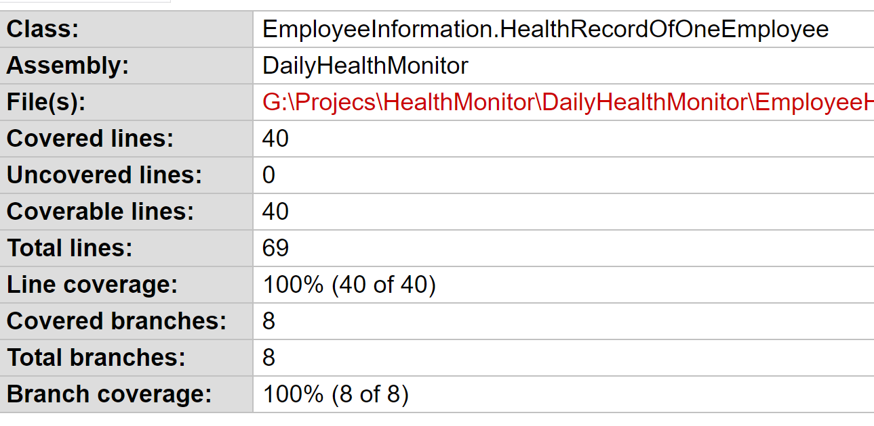
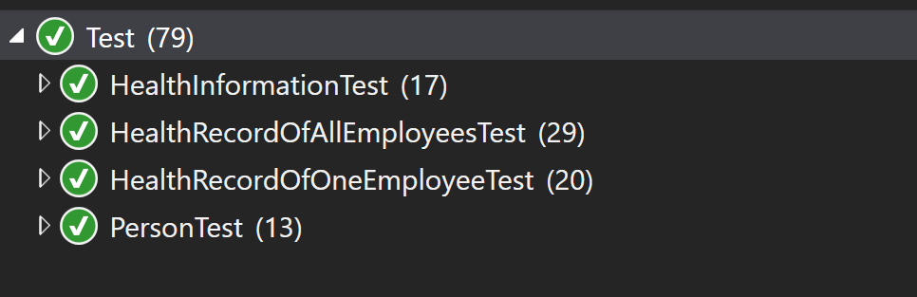
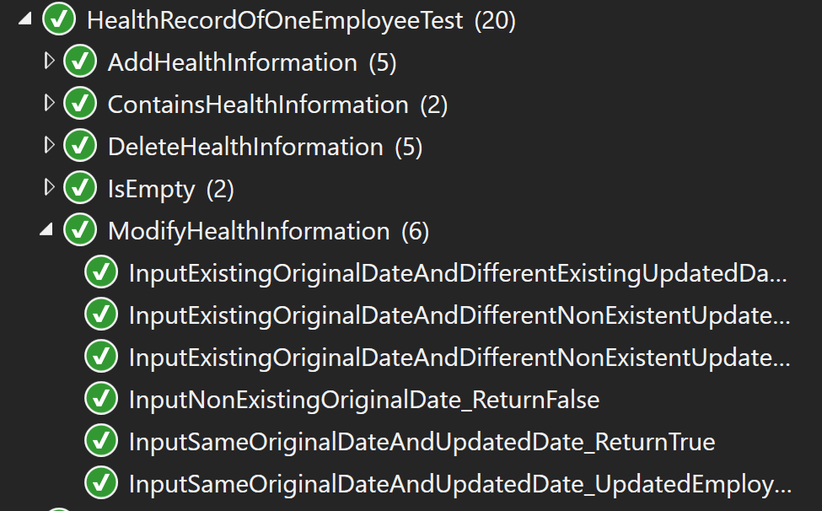
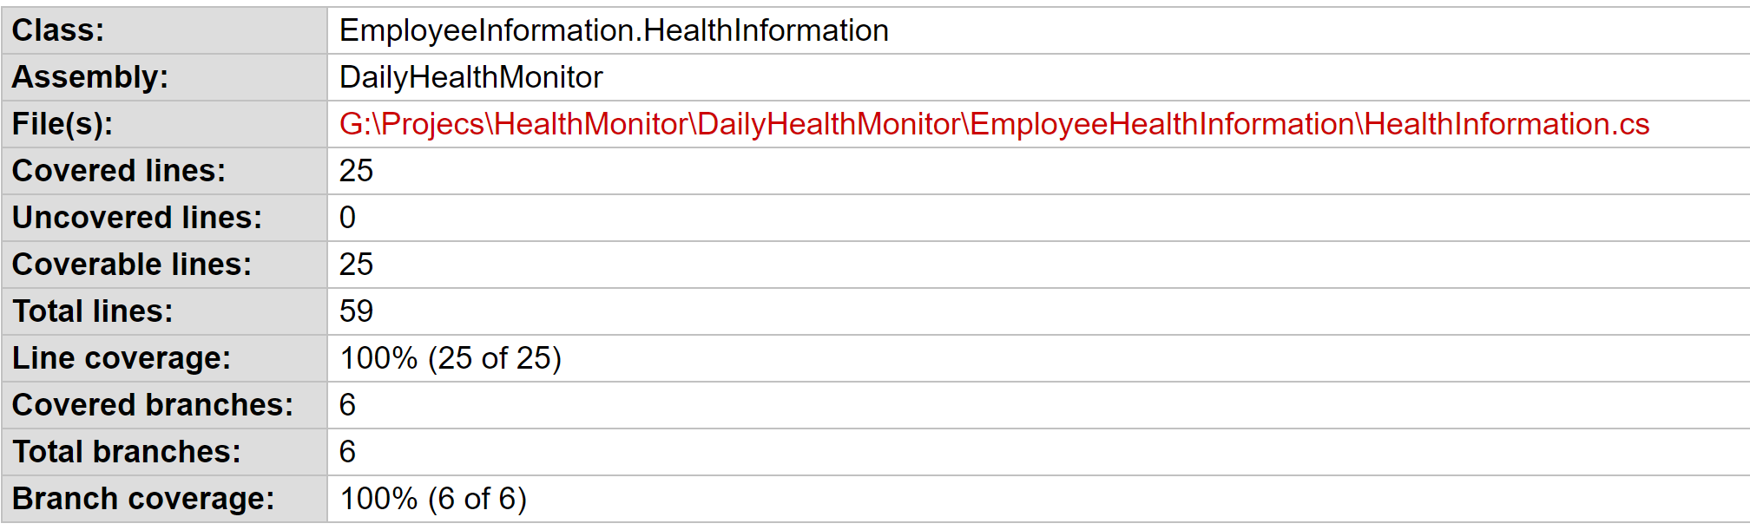
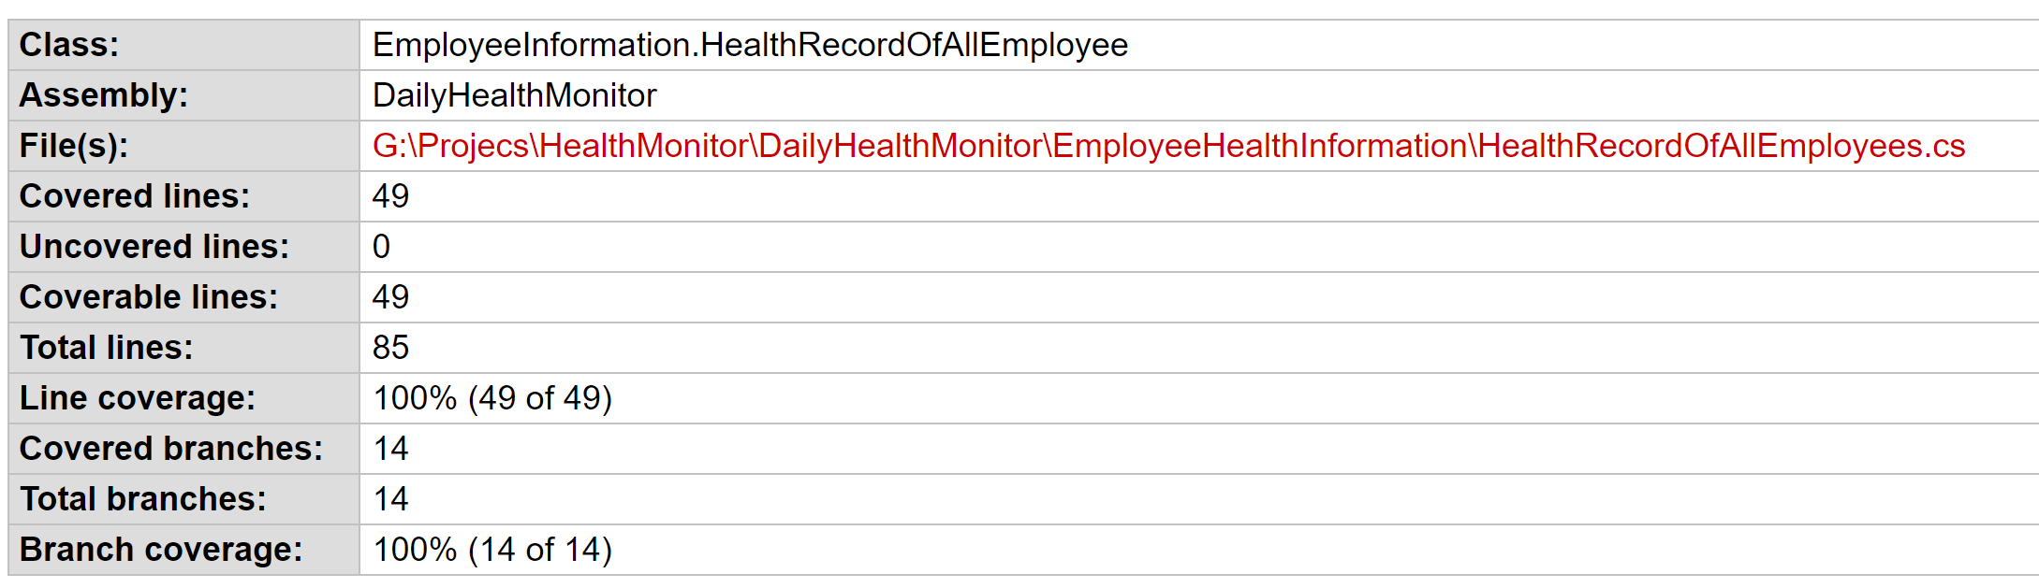
Quality Management: Unit Test
100% line coverage of data model
100% branch coverage of data model
Code coverage report generated by OpenCover and ReportGenerator

Slide 42
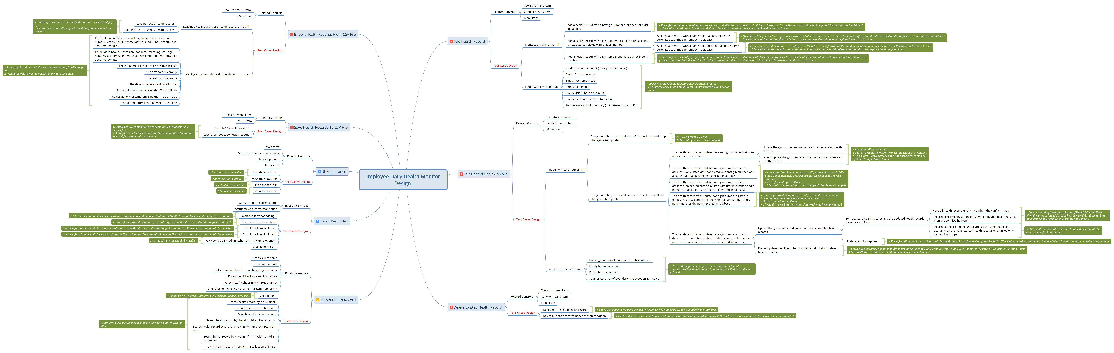
Quality Management: Test Cases Design
Test Cases Design: Mindmap

Slide 43
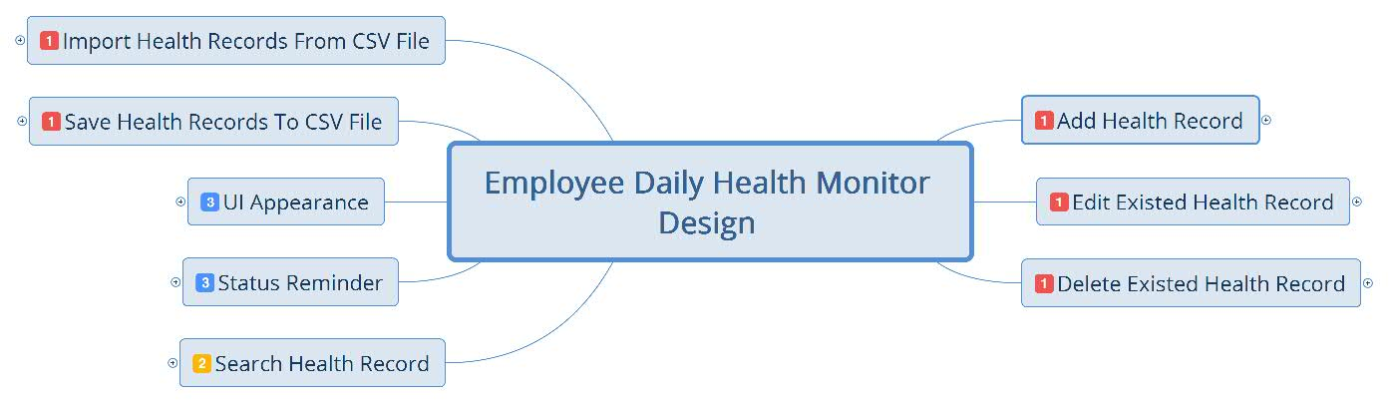
Test Cases Design: Mindmap

Slide 44
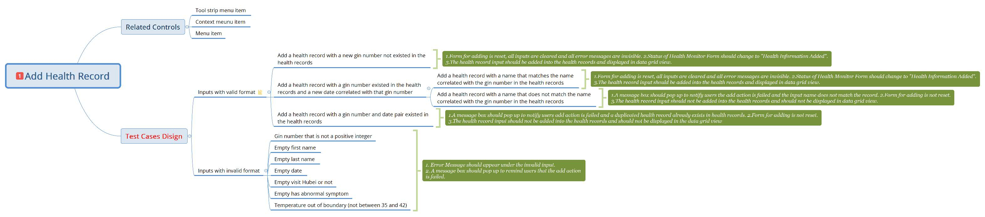
Test Cases Design: Mindmap

Slide 45
Project Name： | Employee Daily Health Monitor Design
Test Designed by： | Shishi
Test Designed Date: | 4/21/2020
Test Executed by: | Shishi
Test Execution date: | 4/21/2020
Test Environment: | OS:Windows 10 Pro, 64-bit Operating System, x64-based processor.
Test Suite: | TS001
Test Case ID | Test Priority | Test Case Summary | Related Requirement | Prerequisites | Test Procedure | Test Data | Expected Result | Actual Result | Status | Remarks
TC001 | High | To verify that clicking the add button in Health Monitor Form opens a form for adding. | RS001 | 1.Health Monitor Form is ready. | 1.Click add button in Health Monitor Form. | Health Records.csv G:\HealthRecord\PrimeService\datafile\HealthRecords.csv | 1.A form for adding which includes empty input fields should pop up. 2.Status of Health Monitor Form should change to "Adding". | Same as expected. | Success
TC002 | High | To verify that clicking add button adds valid health record input into health records. | RS001 | 1.Health Monitor Form is ready. | 1.Click add button in Health Monitor Form. 2.Enter a valid gin number (positive integer) that not exited in health records. 3.Enter first name. 4.Enter last name. 5.Choose date. 6.Choose visited Hubei or not. 7.Choose has abnormal symptom or not. 8.Enter a body temperature between 35 and 42 degree. 9.Submit add. | Health Records.csv G:\HealthRecord\PrimeService\datafile\HealthRecords.csv | 1.Form for adding is reset, all inputs are cleared and all error messages are invisible. 2.Status of Health Monitor Form should change to "Health Information Added". 3.The health record input should be added into the health records and displayed in data grid view. | Same as expected. | Success
TC003 | High | To verify that clicking add button in form for adding validates inputs and reminds user when gin number is not a positive integer. | RS008 | 1.Health Monitor Form is ready. | 1.Click add button in Health Monitor Form. 2.Enter a gin number that is not a positive integer. 3.Enter first name. 4.Enter last name. 5.Choose date. 6.Choose visited Hubei or not. 7.Choose has abnormal symptom or not. 8.Enter a body temperature between 35 and 42 degree. 9.Submit add. | Health Records.csv G:\HealthRecord\PrimeService\datafile\HealthRecords.csv | 1.Error messages should appear under gin number input to notify users how to correct the invalid input. 2.A message box should pop up to notify users that the add action is failed. 3.Form for adding is not reset. 4.The health record input should not be added into the health records and should not be displayed in data grid view. | Same as expected. | Success
Test Cases Design: Excel Table

Slide 46
Quality Management: Conclusion
Skill developed or improved
Hard skills
Test driven design
Test cases design
Soft skills
Communication skills: accurate, effective

Slide 47

Fresh Out Training Periodic Summary
Knowledge and Skills: OOP in C#, Windows forms, quality management
Deeper understanding of Schlumberger: work process, culture
Learning experience and appreciation
Go!
People, Technology, Profit

Slide 48
Thank You!

